Slide 1
seCURE DATA HIDING IN IMAGES USING STEGANOGRAPHY
CAPSTONE PROJECT
Presented By:
Student Name : Mohd Amaan
College Name & Department : Indian Institute of Information Technology Kota, Computer Science & Engineering

Slide 2
OUTLINE
Problem Statement
Technology used
Wow factor
End users
Result
Conclusion
Git-hub Link
Future scope

Slide 3
Problem Statement
The rise in digital communication has increased the need for secure data transmission. Traditional encryption methods can attract unwanted attention, making data hiding crucial. This project uses image steganography to embed secret messages within images, ensuring confidentiality. The message is encoded using pixel values and retrieved with a passcode, enhancing security.

Slide 4
Technology used
Programming Language: Python
Libraries Used: OpenCV (cv2) for image processing, OS for file handling, String for character mapping,
Streamlit for UI and Deployment
Platform: Windows (Compatible with other OS with minor modifications)
Encryption Method: Pixel-based data embedding in images
Decryption: Passcode-protected message extraction from the image

Slide 5
Wow factors
Stealthy Data Hiding: Unlike encryption, which may attract attention, this method hides data within images,
making it inconspicuous.
Passcode Protection: Ensures that only authorized users can decrypt the hidden message,
adding an extra layer of security.
Lightweight & Fast: Uses simple pixel manipulation, making encoding and decoding quick and efficient.
No Additional Storage Needed: The image itself acts as the carrier of the message, eliminating the
need for separate encrypted files.
Custom Character Mapping: Uses a unique approach to map characters to pixel values, enhancing data security.

Slide 6
End users
Journalists & Activists: Securely transmit sensitive information without attracting attention.
Government & Defense: Used for confidential communication in intelligence operations.
Corporate Sector: Protect trade secrets and confidential data from cyber threats.
General Users: Send private messages without detection in digital images.
Cybersecurity Professionals: Implement steganography techniques for secure data transmission.

Slide 7
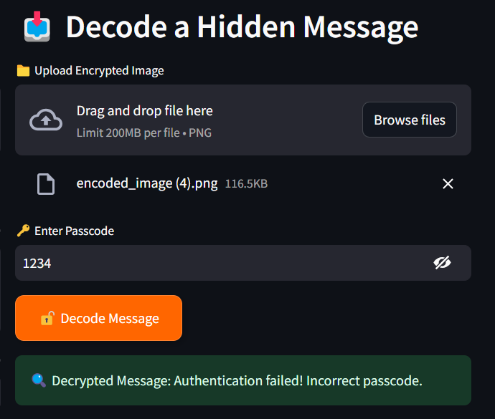
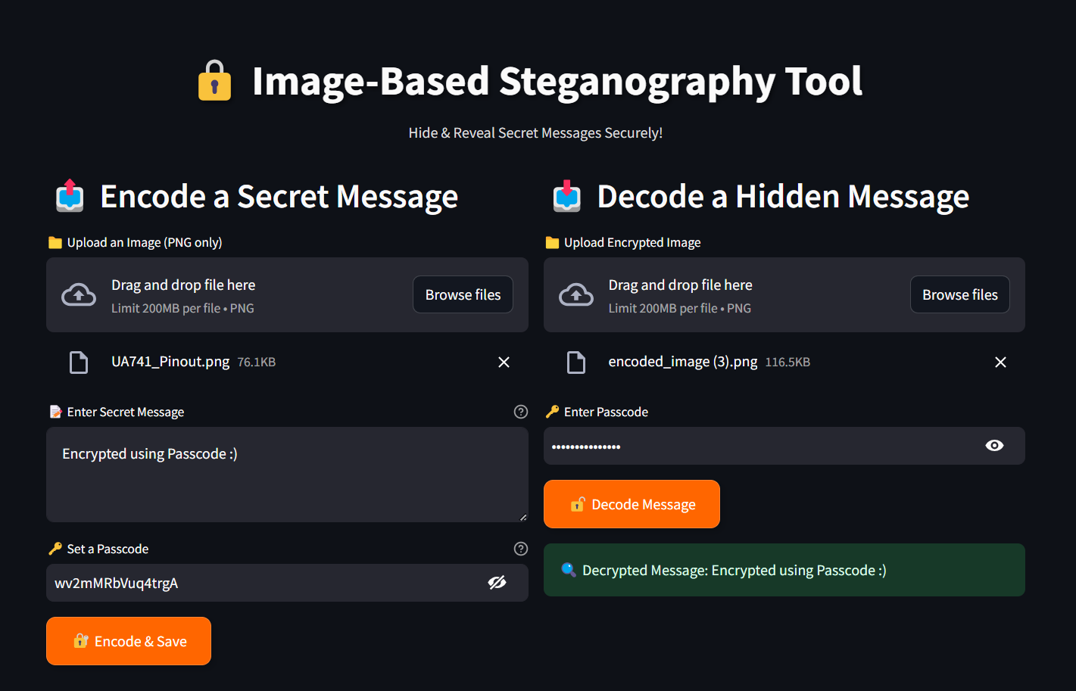
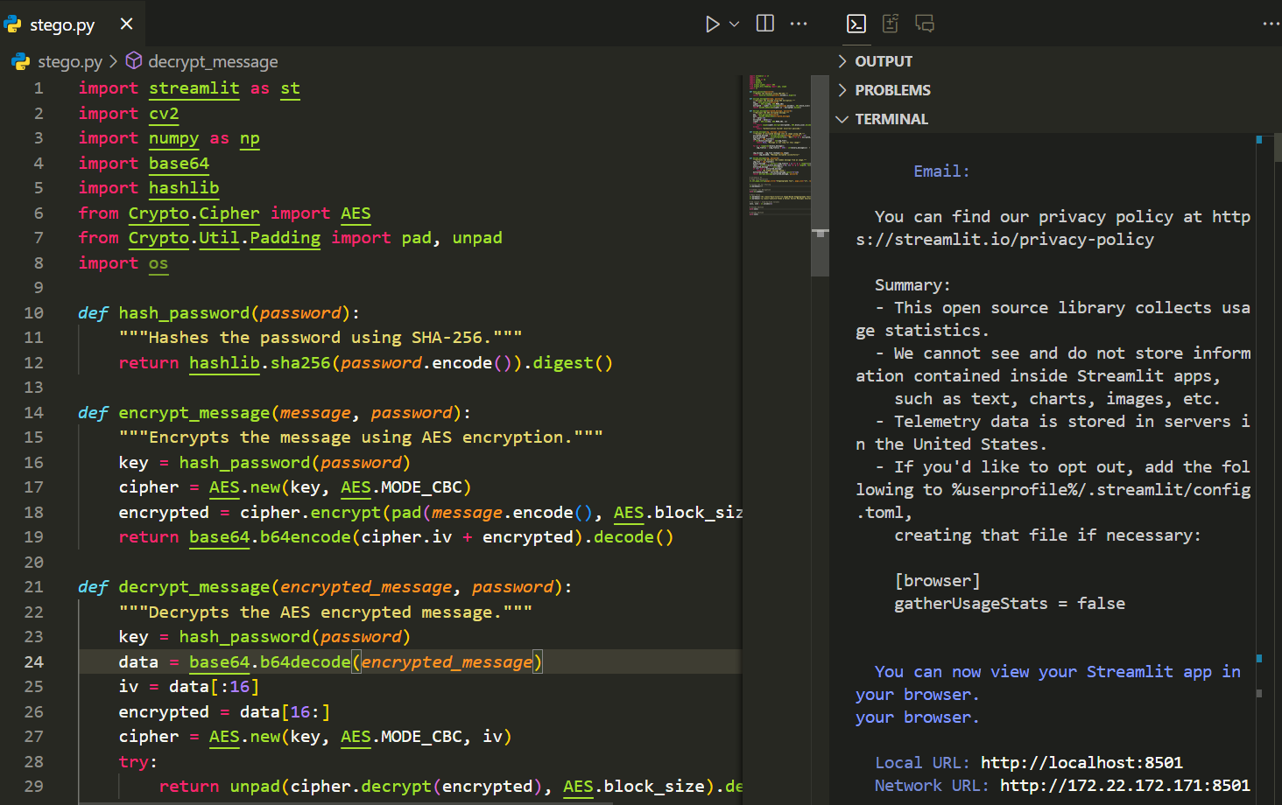
Results
Authentication failed
Error on wrong passcode =>
Deployed on Streamlit
Code =>

Slide 8
Conclusion
This project successfully addresses the need for secure and discreet data transmission by leveraging image steganography. Unlike traditional encryption methods, it embeds messages within images, making them less detectable. The added passcode protection enhances security, ensuring only authorized users can retrieve the hidden data. This approach provides an efficient, lightweight, and practical solution for confidential communication in various fields.

Slide 9
GitHub Link
GitHub Link: https://github.com/mohd-amaan1/Image-Steganography
Live Link: https://stego-image.streamlit.app/

Slide 10
Future scope(optional)
Enhanced Security: Implement stronger encryption techniques alongside steganography to further
secure hidden messages.
Increased Capacity: Optimize algorithms to embed larger amounts of data without compromising image quality.
Multi-Layer Steganography: Hide data in multiple layers of an image to make detection even harder.
Cross-Platform Compatibility: Develop a user-friendly GUI and mobile application for easier access and usage.
AI-Powered Detection Resistance: Use machine learning techniques to counter steganalysis and prevent detection
by advanced security systems.

Slide 11
THANK YOU

